Slide 1


UNIT 1; With you from the start
Parenting

Slide 2
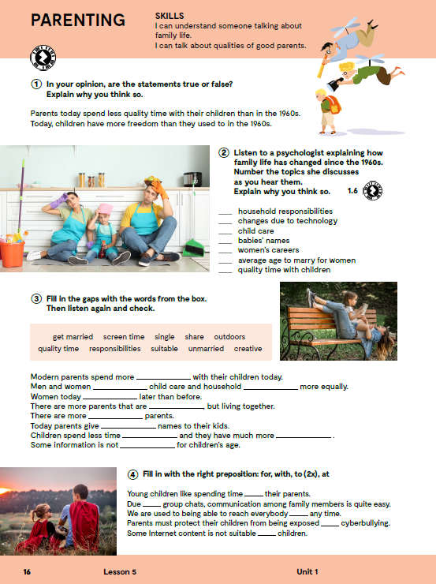
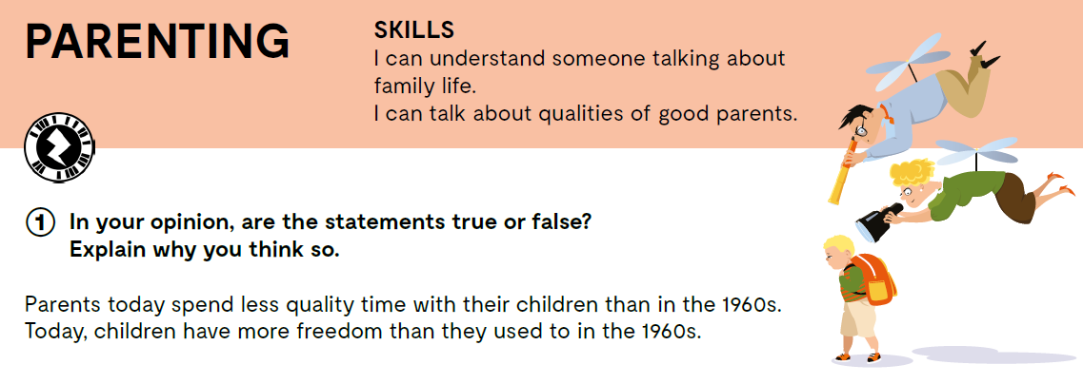

Slide 3

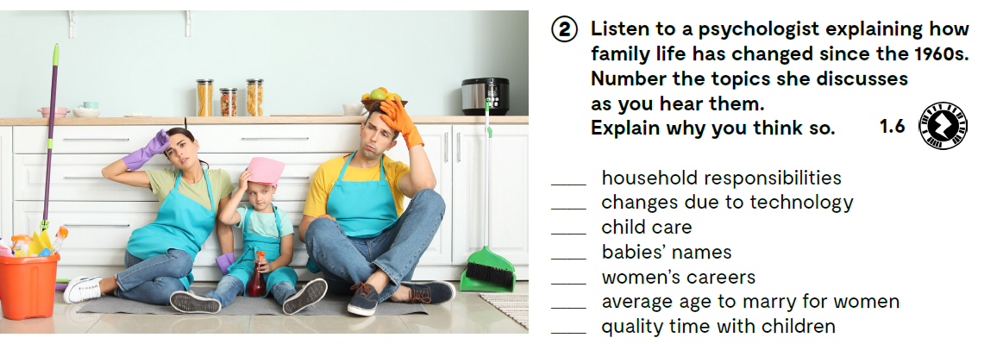
https://www.e-sfera.hr/dodatni-digitalni-sadrzaji/fc3500e3-9d67-4608-9fec-6e95fa264764/assets/audio/1_6.mp3
Check.
4
7
3
6
2
5
1

Slide 4
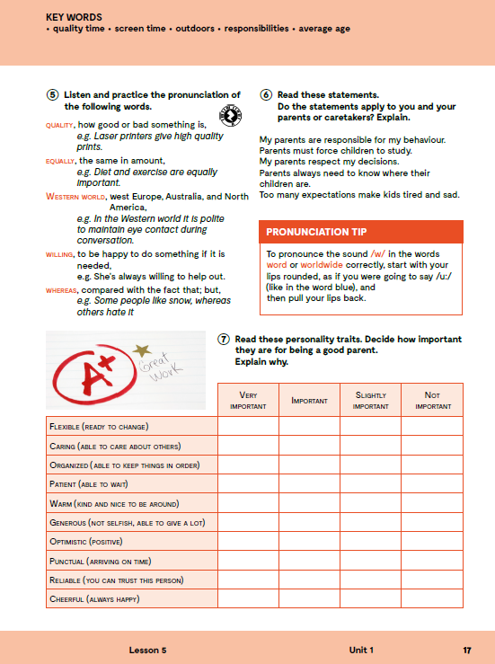
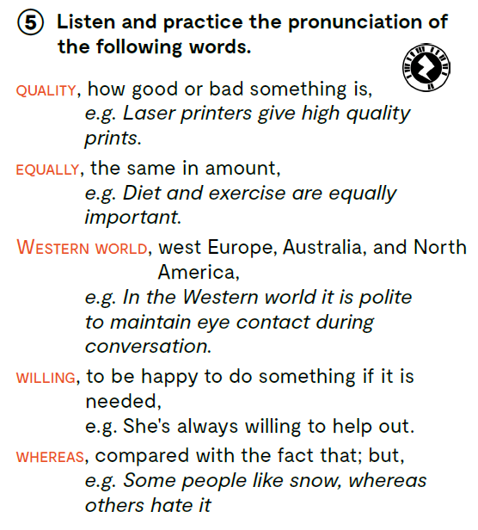
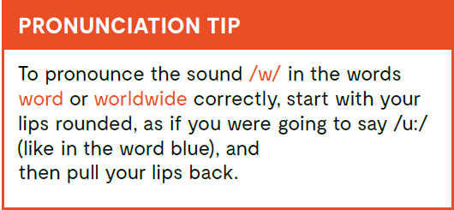
https://www.e-sfera.hr/dodatni-digitalni-sadrzaji/fc3500e3-9d67-4608-9fec-6e95fa264764/assets/audio/unit_1_lesson_5_mg_2-01.mp3

Slide 5
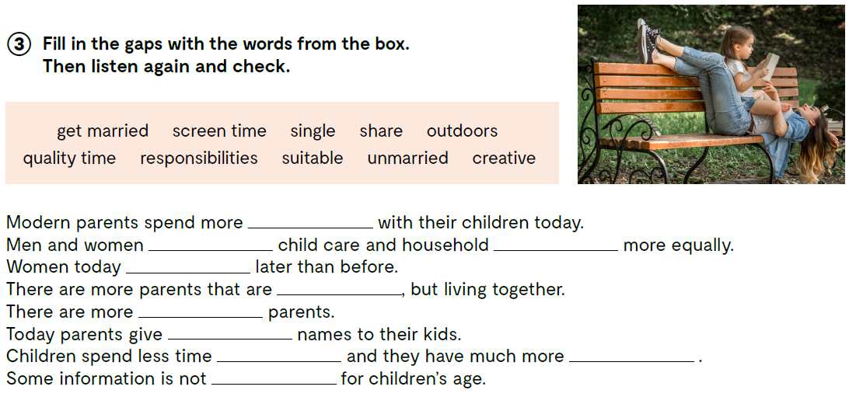
quality time
share
responsibilities
get married
unmarried
single
creative
outdoors
screen time
suitable

Slide 6
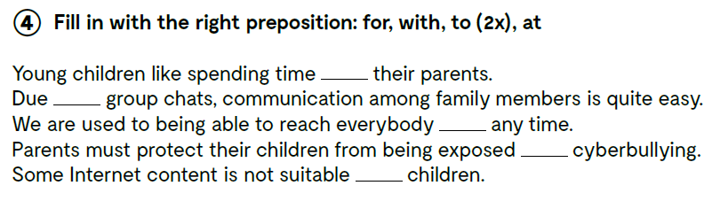
screen time
quality time
child care
average age
to share
outdoors
responsibilities
suitable
unmarried
household
vrijeme pred ekranom
kvalitetno provedeno vrijeme
briga o djetetu
prosječna dob
dijeliti
vani, izvan kuće
dužnosti
prikladno
neoženjen/neudana
kućanstvo
with
to
at
to
for
to spend time with
due to
to reach somebody at any time
to be exposed to
to be suitable for
provoditi vrijeme sa
zbog, kao posljedica
doći do nekoga u bilo koje vrijeme
biti izložen nečemu
biti prikladno za nekoga

Slide 7

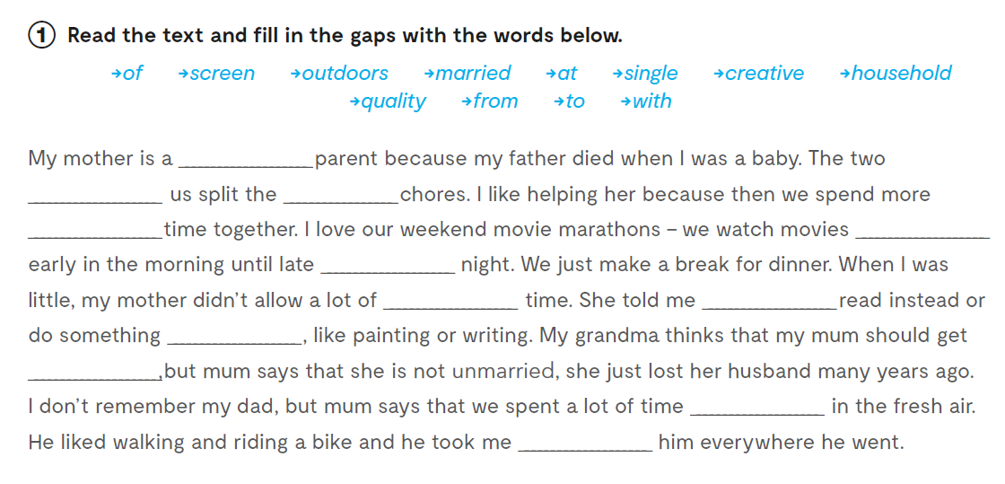
Worbook, p 13.
single
of
househld
quality
from
at
screen
to
creative
married
outdoors
with

Slide 8
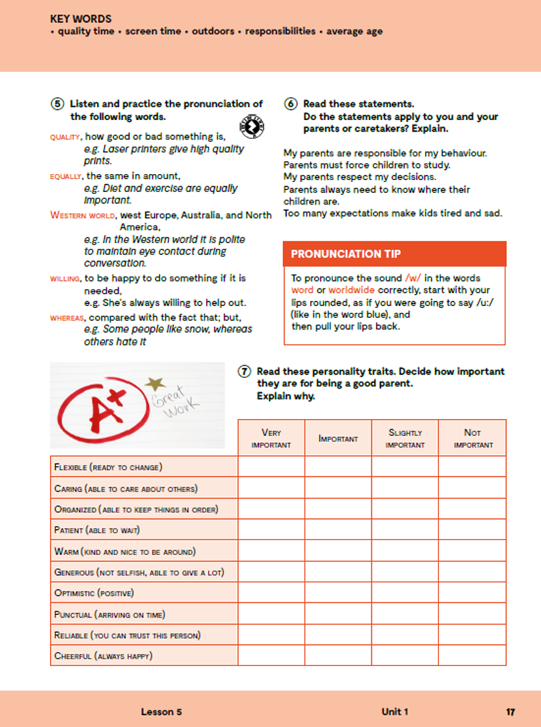
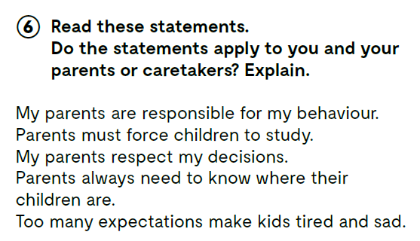

Slide 9
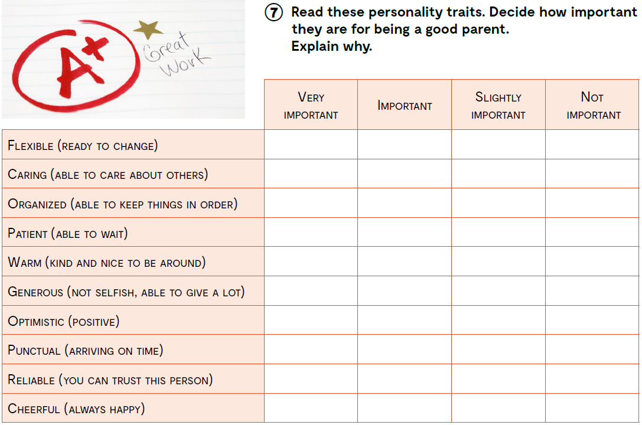
flexible
caring
organized
patient
warm
generous
optimistic
punctual
reliable
cheerful
fleksibilan, prilagodljiv
brižan
organiziran
strpljiv
topao, drag
velikodušan
optimističan, pozitivan
točan
pouzdan
veseo, radostan
Let’s practise:
https://learningapps.org/watch?v=p48gvkepj20

Slide 10
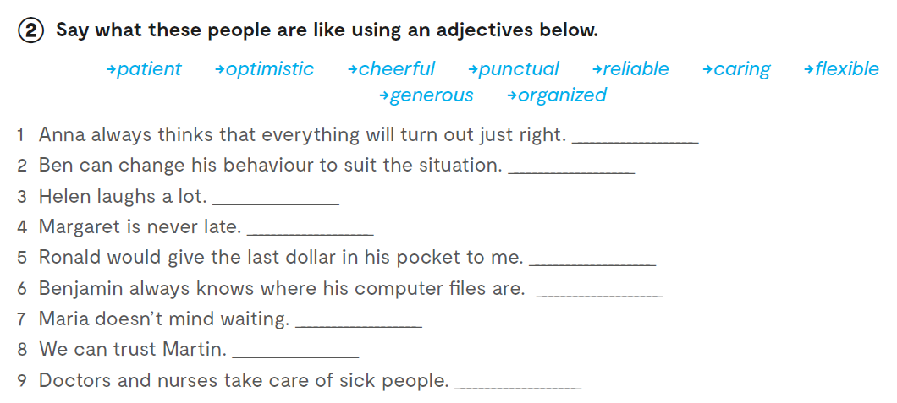
Workbook, p 13.
optimistic
flexible
cheerful
punctual
generous
organized
patient
reliable
caring

Slide 11
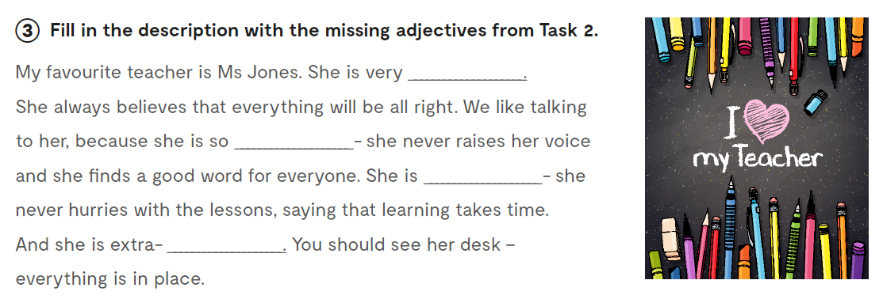
optimistic
caring
patient
organized

Slide 12
